Slide 1
Survey of Different Language Models Available in HuggingFace
By:
Elza cherian

Slide 2
Types of Models
Each one of the models in the library falls into one of the following categories:
Autoregressive models
Auto encoding models
Sequence-to-sequence models
Multimodal models
Retrieval-based models

Slide 3
Autoregressive models
They are pre-trained on the classic language modeling task: guess the next token having read all the previous ones.
They correspond to the decoder of the original transformer model, and a mask is used on top of the full sentence so that the attention heads can only see what was before in the next, and not what’s after.
Although those models can be fine-tuned and achieve great results on many tasks, the most natural application is text generation.
These models rely on the decoder part of the original transformer and use an attention mask so that at each position, the model can only look at the tokens before the attention heads.
Example of such models is GPT

Slide 4
Name of Model | Pre-Trained on | Application
Original GPT | Book Corpus | Language modeling and multitask language modeling/multiple choice classification
GPT-2 | WebText (web pages from outgoing links in Reddit with 3 karmas or more) | Language modeling and multitask language modeling/multiple choice classification
CTRL | Wikipedia, subreddits, OpenWebText | Language modeling
Transformer XL | WikiText-103 | Language modeling
Reformer | enwik8 and imagenet64 | Language modeling
XLNet | BooksCorpus and Wikipedia | Language modeling, token classification, sentence classification, multiple choice classification and question answering.

Slide 5
Autoencoding models
They are pre-trained by corrupting the input tokens in some way and trying to reconstruct the original sentence.
They correspond to the encoder of the original transformer model in the sense that they get access to the full inputs without any mask.
Those models usually build a bidirectional representation of the whole sentence.
They can be fine-tuned and achieve great results on many tasks such as text generation, but their most natural application is sentence classification or token classification.
Example: BERT.
Note that the only difference between autoregressive models and autoencoding models is in the way the model is pretrained.
Therefore, the same architecture can be used for both autoregressive and autoencoding models.

Slide 6
Name of Model | Pre-Trained on | Application
BERT | BooksCorpus & Wikipedia | Language modeling (traditional or masked), next sentence prediction, token classification, sentence classification, multiple choice classification and question answering.
ALBERT | BooksCorpus & Wikipedia | Masked language modeling, token classification, sentence classification, multiple choice classification and question answering.
RoBERTa | BooksCorpus, CC-News, OpenWebText, STORIES | Masked language modeling, token classification, sentence classification, multiple choice classification and question answering.
DistilBERT | BooksCorpus & Wikipedia | Masked language modeling, token classification, sentence classification and question answering.

Slide 7
XLM | Trained on different languages | Language modeling, token classification, sentence classification and question answering.
XLM-RoBERTa | Trained on different languages | Masked language modeling, token classification, sentence classification, multiple choice classification and question answering.
FlauBERT | Wikipedia | Language modeling and sentence classification
ELECTRA | BooksCorpus & Wikipedia, ClueWeb, CommonCrawl, Gigaword | Masked language modeling, token classification and sentence classification
Longformer | QA: WikiHop, TriviaQA, and HotpotQA Conference Resolution: OntoNotes Document Classification: IMDB | Masked language modeling, token classification, sentence classification, multiple choice classification and question answering.

Slide 8
Sequence-to-sequence models
Use both the encoder and the decoder of the original transformer, either for translation tasks or by transforming other tasks to sequence-to-sequence problems.
They can be fine-tuned to many tasks but their most natural applications are translation, summarization and question answering.
Example: original transformer model (only for translation), T5 (can be fine-tuned on other tasks)
Name of Model | Pre-Trained on | Application
BART | WikiNews | Conditional generation and sequence classification
Pegasus | News Articles like CNN/DailyMail | Conditional generation, which should be used for summarization
MarianMT | English-German news | Conditional generation
T5 | Common Crawl | Conditional generation
MBART | Common Crawl from different languages | Conditional generation, translation, and summarization

Slide 9
Multimodal models
Mix text inputs with other kinds (e.g. images) and are more specific to a given task.
Name of Model | Pre-Trained on | Application
MMBT | MM-IMDB, FOOD101 | Classification

Slide 10
Retrieval-based models
Some models use documents retrieval during (pre)training and inference for open-domain question answering, for example
Name of Model | Pre-Trained on | Application
DPR | Wikipedia and QA datasets: TriviaQA, WebQuestions | State-of-the-art open-domain question-answering research

Slide 11
Reformer
Using Reformer to train on sequences of half a million tokens using less than 8 GB. Uses lots of tricks to reduce memory footprint and compute time.
Use Axial position encoding: mechanism to avoid having a huge positional encoding matrix (when the sequence length is very big) by factorizing it into smaller matrices.
Replace traditional attention by LSH (local-sensitive hashing) attention: technique to avoid computing the full product query-key in the attention layers.
Avoid storing the intermediate results of each layer by using reversible transformer layers to obtain them during the backward pass (subtracting the residuals from the input of the next layer gives them back) or recomputing them for results inside a given layer (less efficient than storing them but saves memory).
Compute the feedforward operations by chunks and not on the whole batch.
With those tricks, the model can be fed much larger sentences than traditional transformer autoregressive models.

Slide 12
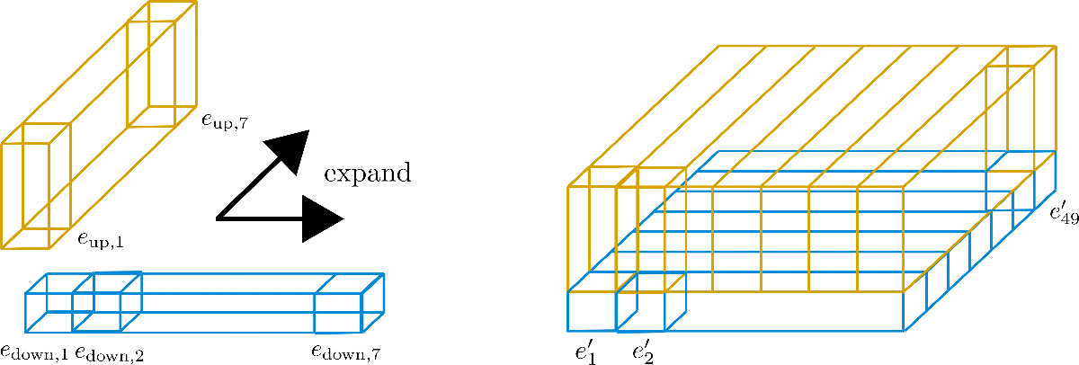
Axial position encoding
In traditional transformer models, the positional encoding E is a matrix of size l X d, l being the sequence length and d the dimension of the hidden state.
If you have very long texts, this matrix can be huge and take way too much space on the GPU.
To alleviate that, axial positional encodings consist of factorizing that big matrix E in two smaller matrices E1 and E2, with dimensions l1×d1 and l2×d2, such that l1×l2=l and d1+d2=d (with the product for the lengths, this ends up being way smaller).
The embedding for time step j in E is obtained by concatenating the embeddings for timestep j%l1 in E1 and j//l1 in E2.

Slide 13
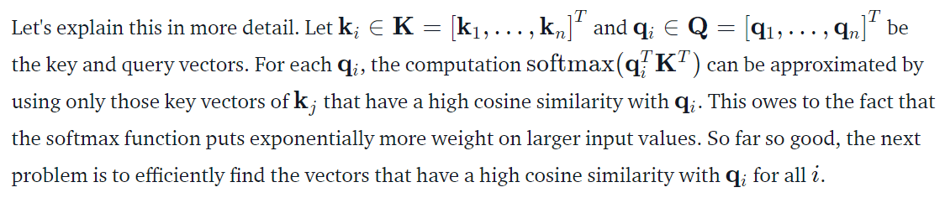
Local-sensitive hashing
The idea behind LSH self-attention is based on the insight that if n is large, the softmax applied on the QK^T attention dot-product weights only very few value vectors with values significantly larger than 0 for each query vector.
Most transformer models use full attention in the sense that the attention matrix is square. It can be a big computational bottleneck when you have long texts.
Longformer and reformer are models that try to be more efficient and use a sparse version of the attention matrix to speed up training.

Slide 14
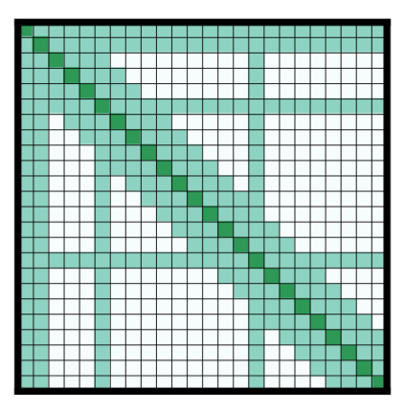
Longformer
A transformer model replacing the attention matrices by sparse matrices to go faster.
Uses local attention: often, the local context (e.g., what are the two tokens to the left and right?) is enough to take action for a given token. Also, by stacking attention layers that have a small window, the last layer will have a receptive field of more than just the tokens in the window, allowing them to build a representation of the whole sentence.
Some preselected input tokens are also given global attention: for those few tokens, the attention matrix can access all tokens and this process is symmetric: all other tokens have access to those specific tokens (on top of the ones in their local window).
Using those attention matrices with less parameters then allows the model to have inputs having a bigger sequence length.

Slide 15
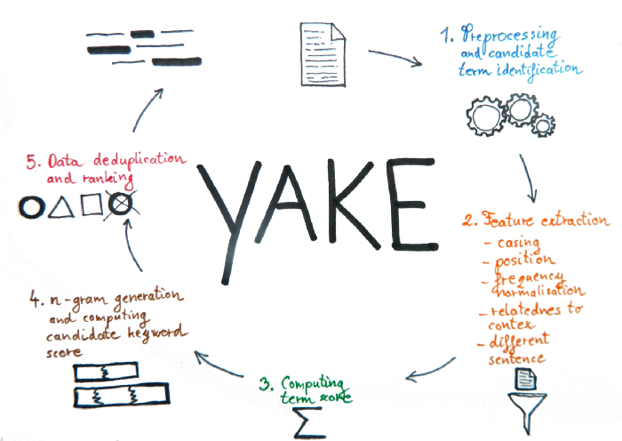
Yet Another Keyword Extractor(Yake)
Light-weight unsupervised automatic keyword extraction method which rests on text statistical features extracted from single documents to select the most important keywords of a text.
Does not need to be trained on a particular set of documents, neither it depends on dictionaries, external-corpus, size of the text, language or domain.

Slide 16
Different notebooks in HuggingFace Transformer: https://huggingface.co/transformers/v4.2.2/notebooks.html
Fine tuning language model: https://github.com/huggingface/notebooks/blob/master/examples/language_modeling.ipynb
Using Reformer to train on sequences of half a million tokens using less than 8 GB: https://github.com/huggingface/blog/blob/master/notebooks/03_reformer.ipynb
Training language model: https://colab.research.google.com/github/huggingface/notebooks/blob/master/examples/language_modeling_from_scratch.ipynb#scrollTo=5WBhUmrvkZBJ
https://colab.research.google.com/github/allenai/longformer/blob/master/scripts/convert_model_to_long.ipynb#scrollTo=7AZZ4VmKSwvH
In-depth understanding of each of the four Reformer features: https://github.com/huggingface/blog/blob/master/notebooks/03_reformer.ipynb

Slide 17
Reformer can be leveraged for masked language modeling: https://github.com/patrickvonplaten/notebooks/blob/master/Reformer_For_Masked_LM.ipynb
Fine tune transformer for language modeling: https://github.com/huggingface/notebooks/blob/master/examples/language_modeling.ipynb
Train a Longformer model starting from the RoBERTa checkpoint: https://github.com/allenai/longformer/blob/master/scripts/convert_model_to_long.ipynb
Longformer for QuestionAnswering: https://github.com/patil-suraj/Notebooks/blob/master/longformer_qa_training.ipynb
How nlp can be leveraged to evaluate Longformer on TriviaQA: https://github.com/patrickvonplaten/notebooks/blob/master/How_to_evaluate_Longformer_on_TriviaQA_using_NLP.ipynb
Code examples for longformer: https://github.com/christianversloot/machine-learning-articles/blob/main/transformers-for-long-text-code-examples-with-longformer.md

Slide 18
Yake: https://github.com/LIAAD/yake
Summary of different model: https://huggingface.co/transformers/v3.1.0/model_summary.html#autoencoding-models
Yake explanation blog:
https://towardsdatascience.com/keyword-extraction-methods-the-overview-35557350f8bb
https://towardsdatascience.com/keyword-extraction-a-benchmark-of-7-algorithms-in-python-8a905326d93f

